Slide 1

Do we need to switch to a circular economy in the plastics sector?
Kick off meeting
Kraków | 26 April 2023
BUT, Faculty of Chemistry (AP) Prof. Adriana Kovalčík
Notes:
Please keep in mind that : . If other logos are displayed in addition, the EU emblem (which is an integral part of the programme and project logo) has to have at least the same size, measured in height or width, as the biggest of the other logos."

Slide 2
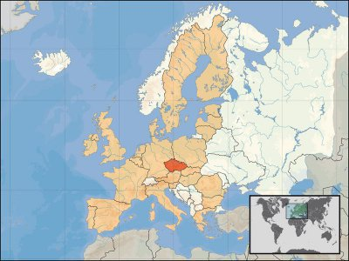
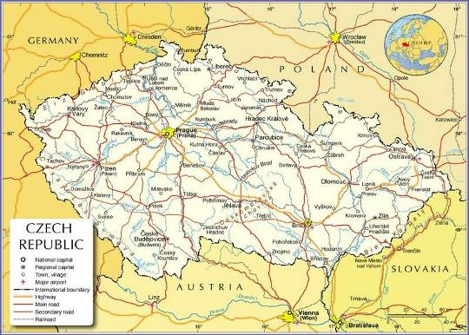
BRNO

Slide 3

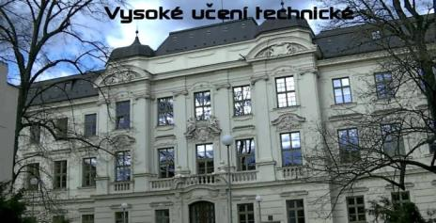
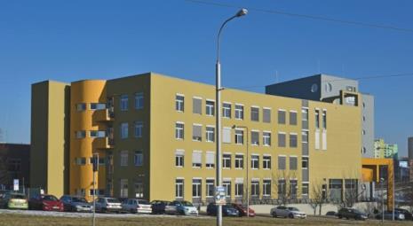
2nd largest Technical University in Czech Republic (founded in 1899)
World University Ranking – 701–750th (2023)
18 327 students, 8 faculties and 3 institutes
located at the very heart of Europe, in a picturesque Moravian city Brno
Brno University of Technology
Faculty of Chemistry

Slide 4
CONTENT of presentation
Circular economy – meaning?
Bioplastics – alternative?
Examples of circular economy
from Czech Republic
EU’s new circular economy action plan
Conclusions
Some facts about plastics
Circularity of plastics

Slide 5



Linear and circular way of going/doing/using or reusing
A
PROS of linear economy:
customized
clear and easy way
verified methods and results
profitable
CONS of linear economy
depletion of resources
waste generation
pollution
PROS of circular economy:
re-use of resources
waste reduction
less impact on pollution
development of new products
CONS of circular economy
financially demanding new procedures
the need to use new methodologies and machines
non-existing networking and market
A
B

Slide 6
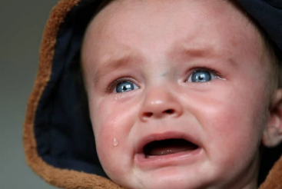

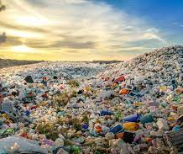

The consequences of linear economics
Plastic pollution, greenhouse gases (3.8%)

Slide 7
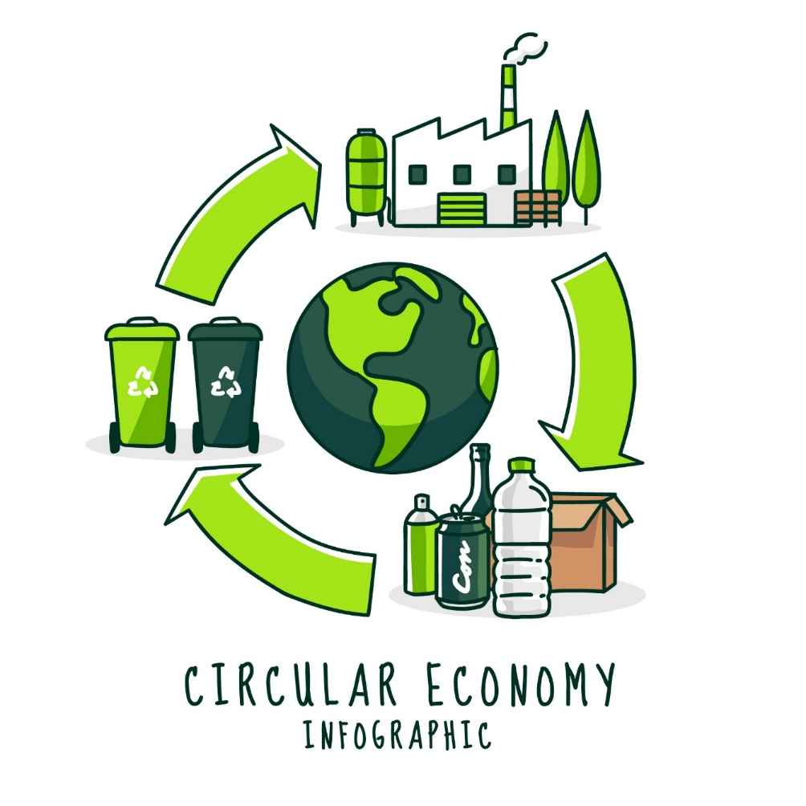


circular economy
Plastics/packaging
Textiles
Food, water, nutrients
Electronics and ICT
Batteries and vehicles
Construction and buildings
Not only plastics are in target
Less waste, more value
and
toxic free environment
https://fonts.google.com/specimen/Sue+Ellen+Francisco

Slide 8
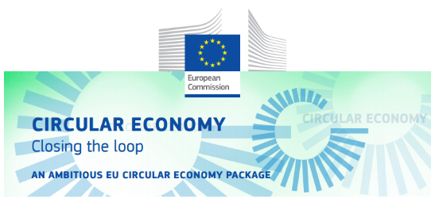

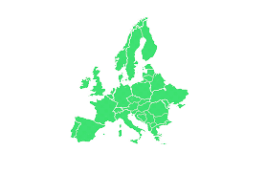
Circular economy – eu vision or almost reality?
EU’s new circular economy action plan (03/2020)
European Green deal
Bio-economy
Climate-neutral
Resource-efficient
Circular economy
cleaner and more competitive Europe

Slide 9
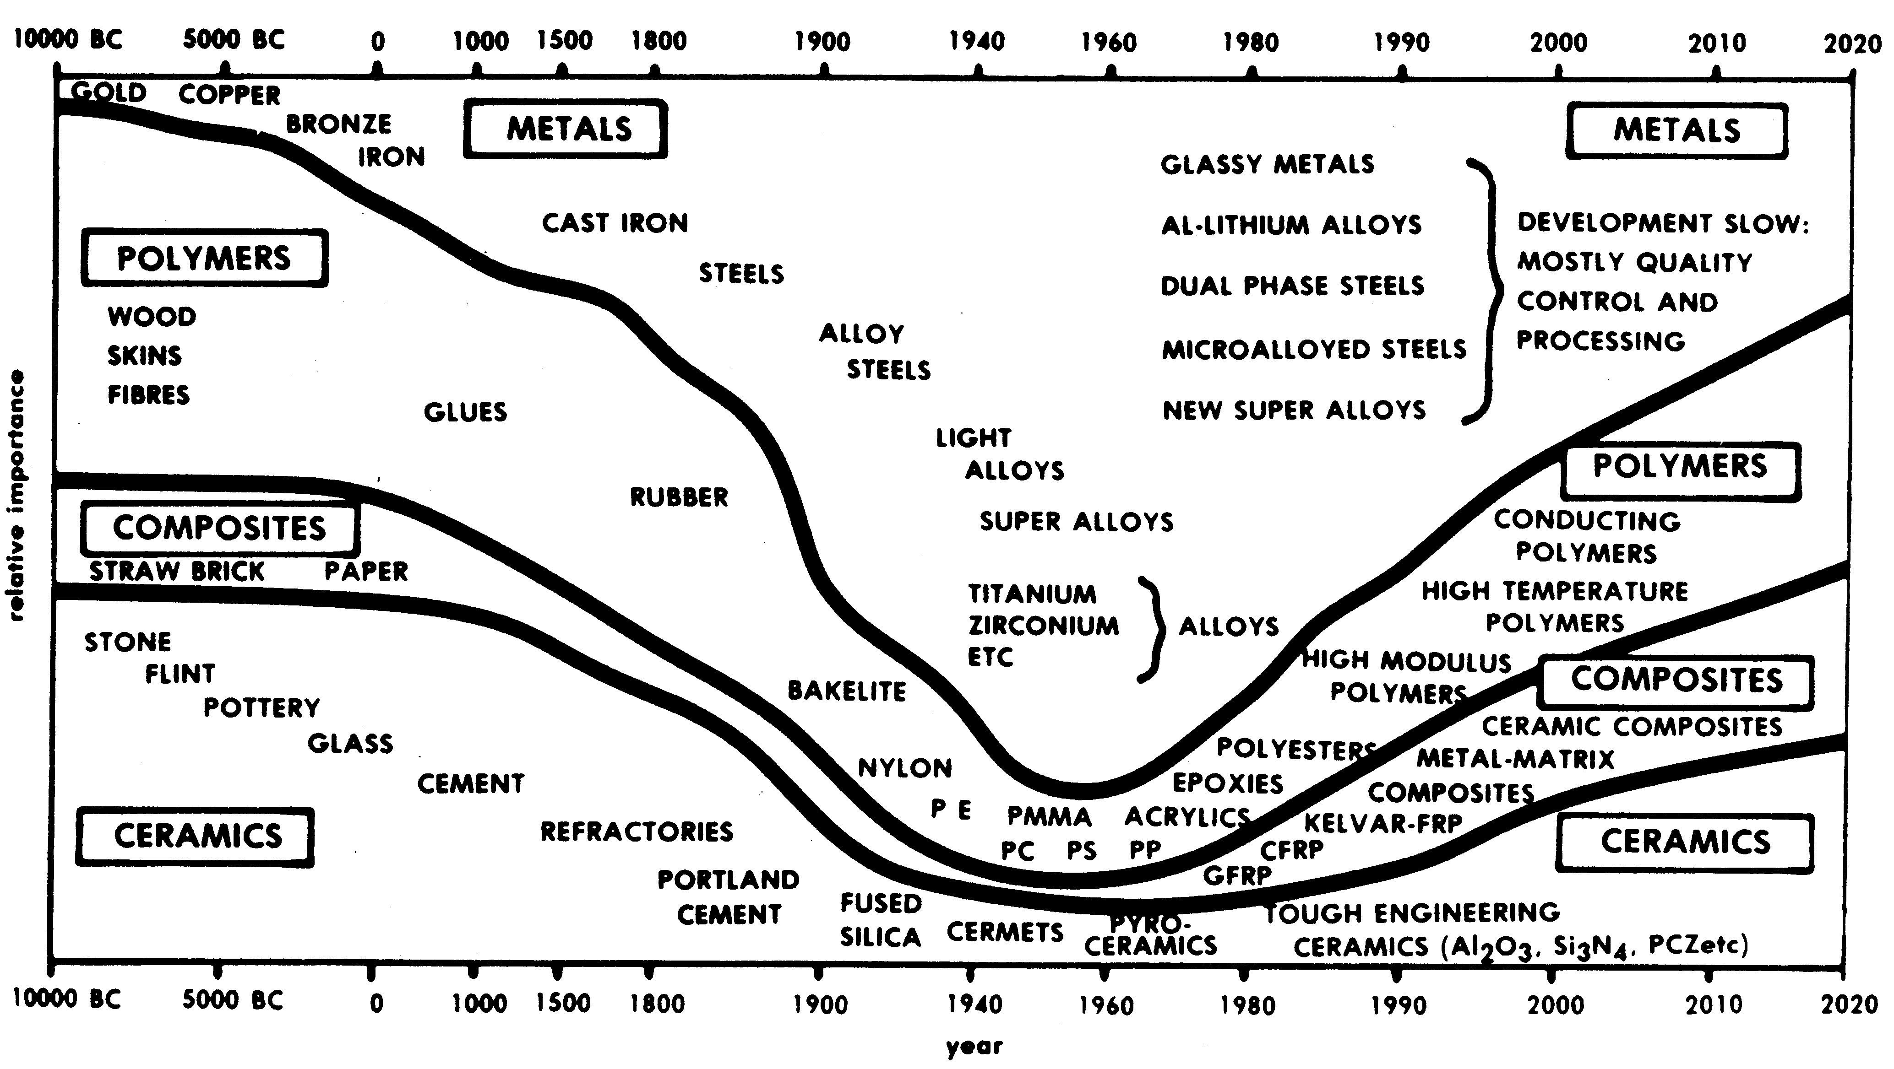
Historical development of plastics use
Froes H., 1990. Aerospace materials for the twenty-first century.
Swiss Materials 2(2), 23-36

Slide 10
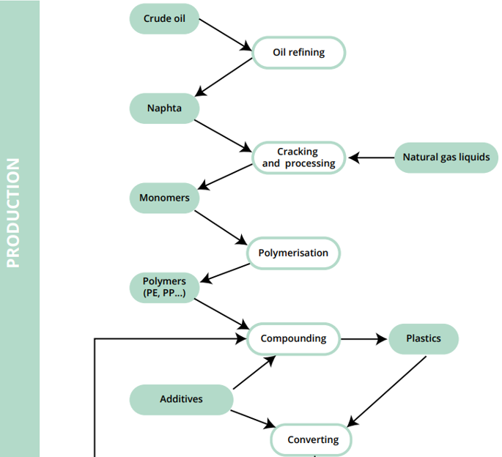
Some facts about plastics
> 99 % of plastics → from fossil fuel resources
Forecast says that the plastics industry will account
for 20 % of global oil use by 2050
Nielsen and Bauer 2019

Slide 11
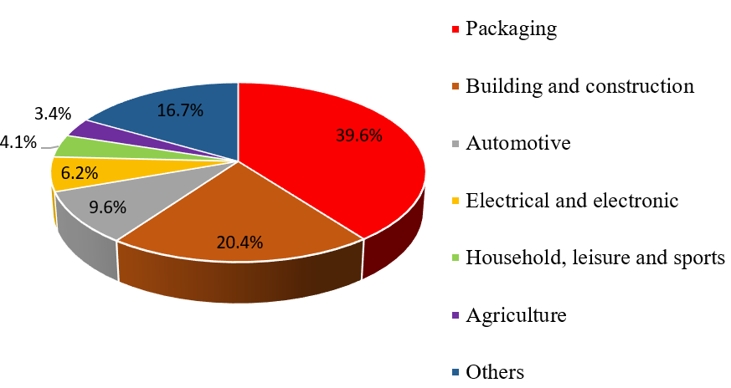
Plastics demand by segment
The global plastics production
increased to 390.7 Mt
in 2021
European plastics
production reached 57.2 Mt
PlasticsEurope, Plastics - the Facts 2020, PlascticsEurope, Belgium, 2020.

Slide 12
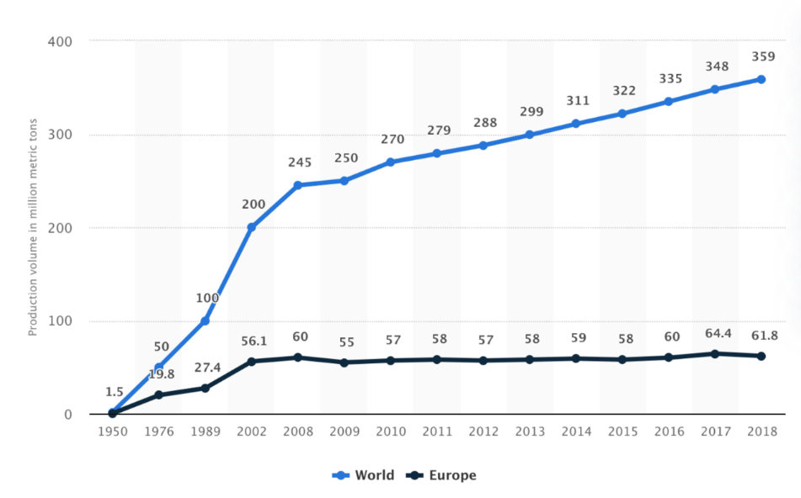
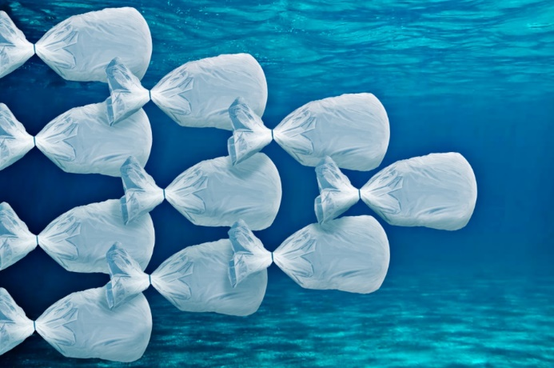
Why are plastics problematic?
Since 1950s, plastic production increased to 359 Mt/year
Cumulatively from 1950 - 2015, 8,300 Mt of plastic was produced, we do not know where ended 6,300 Mt of waste
Fossil-based plastics are not ordinarily biodegradable and may damage the ecosystem
More plastic in the oceans than fish by 2050
https://guillemcasasus.com/

Slide 13


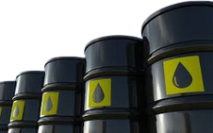
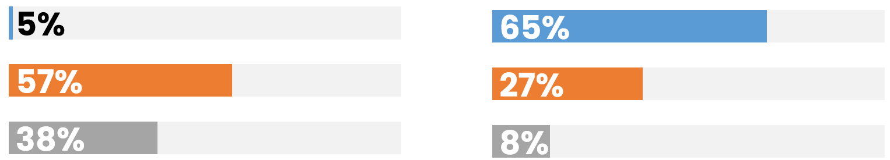


Plastics waste collection in Eu in 2020
Mixed waste collection
Separate waste collection
1 tone of recycled plastic saves 5 barrels of oil and the equivalent of 1.6 tones of CO₂
Recycling
Energy recovery
Landfilling
European post-consumer recycled about 9.9 % of the produced plastics in 2021

Slide 14
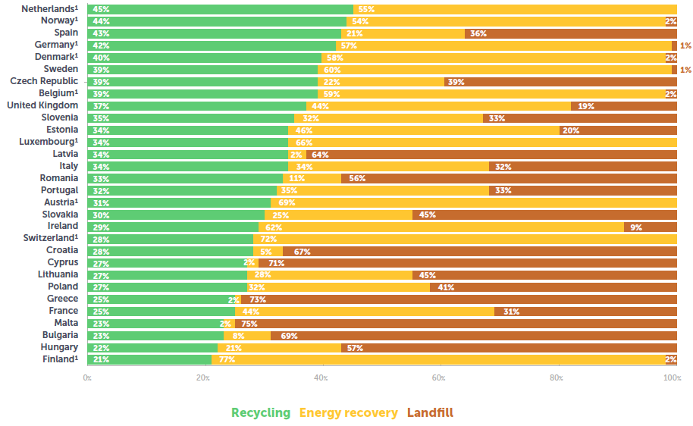
Plastics in Circular economy in 2022
https://plasticseurope.org/knowledge-hub/plastics-the-facts-2022/

Slide 15
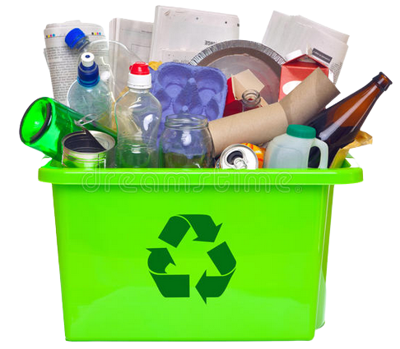
Progress in the circular economy for plastics
Key findings 2022 in the EU27 +3
4.6 million tones
of post-consumer waste recycled plastic used in new plastic products
More than 10 million tones of post-consumer plastic waste sent
for recycling
The plastic waste recycling rate is 13 times higher when collected separately than in mixed collection
Compared to 2018, the amount
of recycled plastic used in packaging increased by 43%
65% of plastic waste not yet recycled
https://plasticseurope.org/

Slide 16
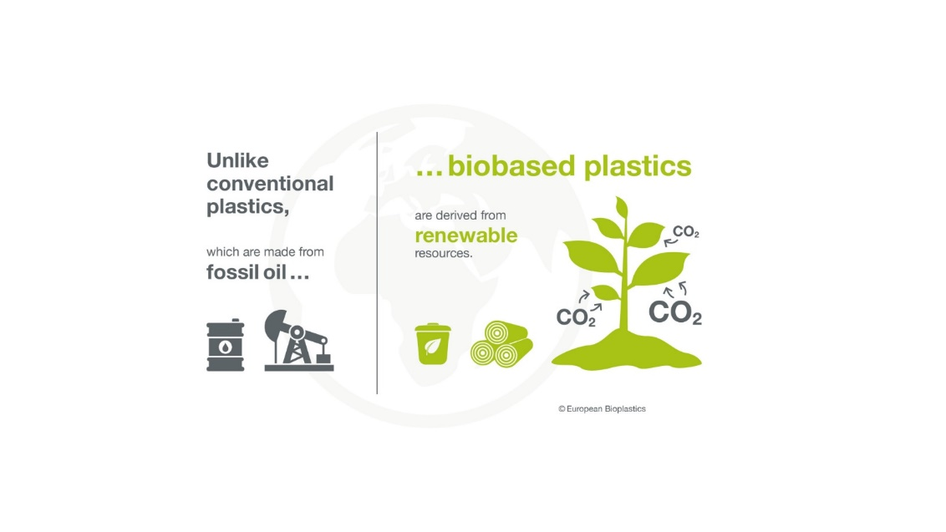
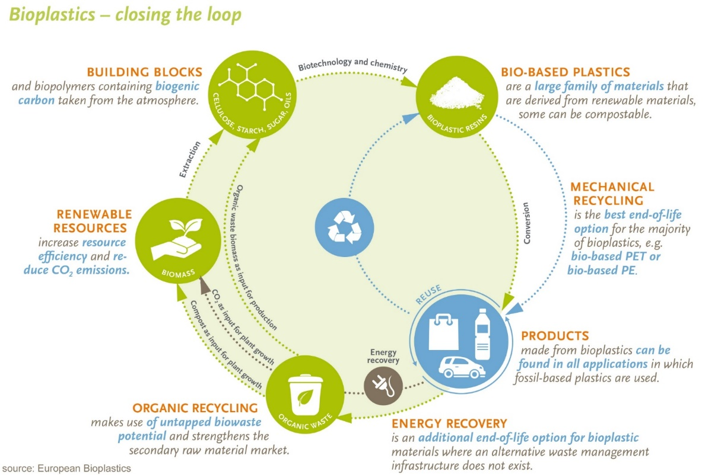
Circularity of plastics? Bioplastics as an alternative?
Biobased’ does not equal ‘biodegradable’!
The recovery way of bioplastics waste depends on the type of product and the recovery systems available.

Slide 17
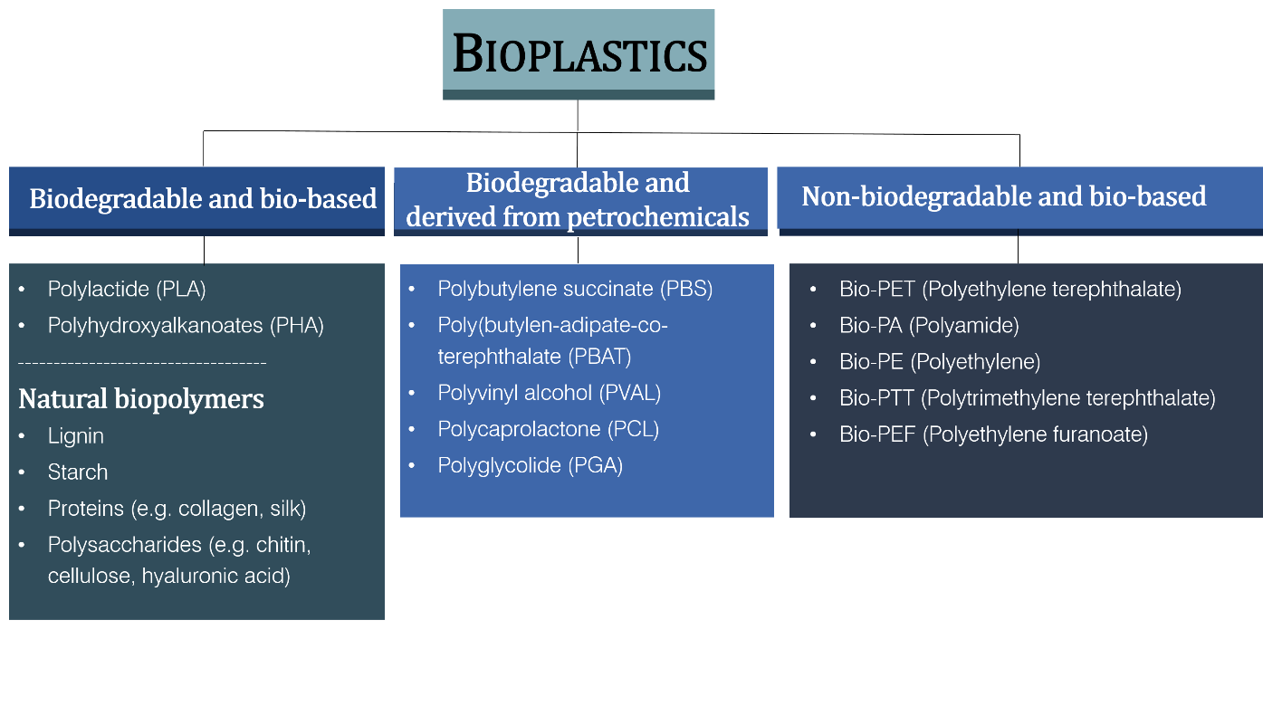
Bioplastics as an alternative?
About 68% of people in the Czech Republic are willing to pay extra for a product that is environmentally friendly
(CSR & Reputation survey Research 2016)
The global bioplastics market is growing at a CAGR of 12.5% however,
it is only 4.25% of the whole plastic market by 2020

Slide 18


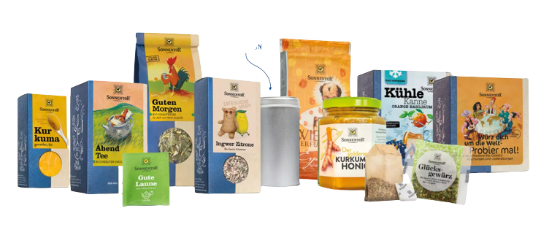

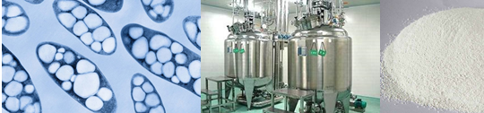
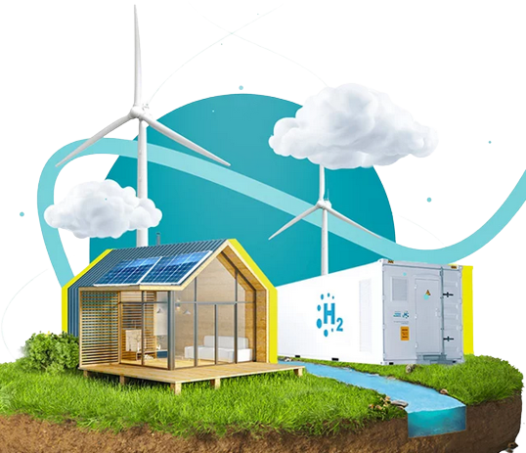

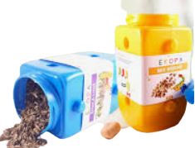

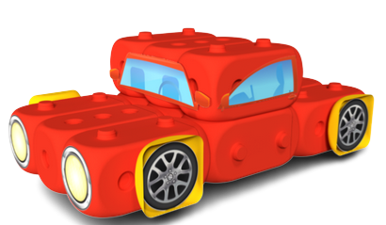
Some examples of companies in the Czech Republic that use bioplastics
Prague, CR
Hydal technology
Hodonín, CR
https://www.sonnentor.com/
https://www.nafigate.com/
Brandýs nad Labem, CR
Brno, CR
https://www.ekopa.cz/
https://www.ciur.cz/en/

Slide 19
Conclusions
Attention! Plastics are essential
for fuel savings and reducing greenhouse gas consumption,
BUT at the same time, plastics are accumulated in the environment
in alarming quantities (plastic paradox)
The plastic waste recycling rate is 13 times higher when collected separately
than in mixed collection.
But only 10% plastics from the whole waste are recycled
Bioplastics have their place in the circular economy, but for some reasons they cannot replace all plastics
The aim is that circular economy plan + European green deal lead to wise use of valuable resources from "waste"
It is necessary
to involve progressive thinking, good legislation and policy, interest
of companies and consumer society

Slide 20
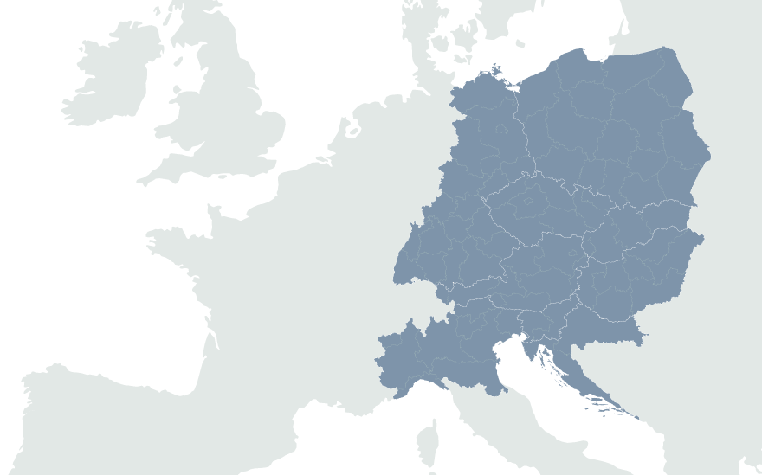
SMART CIRCUIT
Lead Partner: Krakow Technology Park ​
https://www.interreg-central.eu/projects/smart-circuit/
https://twitter.com/smartcircuit_ce
https://www.linkedin.com/company/smartcircuit/
https://www.youtube.com/@SMARTCIRCUIT

